Slide 1
Project - 3
House Grade_Archit

Slide 2
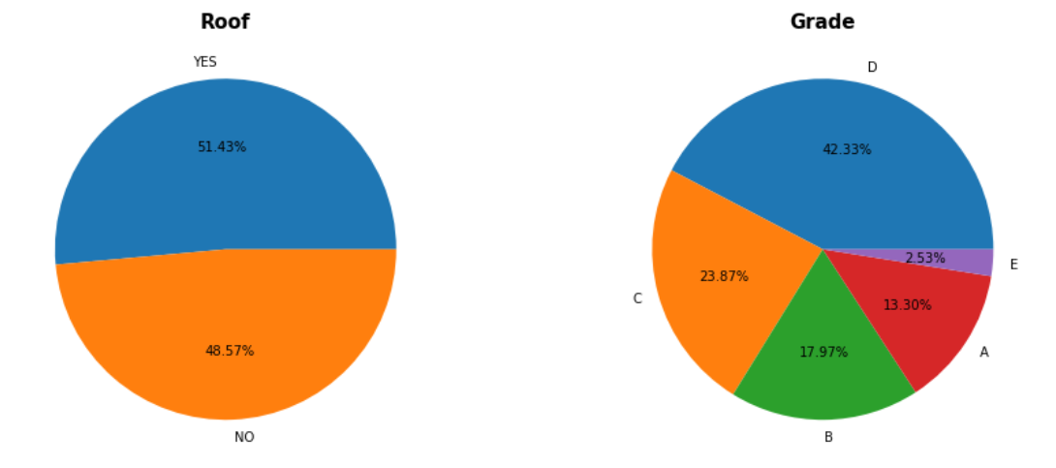
The Houses with 'Roof' are more than the houses without roof that is 51.43% . The Houses with 'Grade D' are more compared to other grades that is 42.33% and least houses are with 'Grade E' that is 2.53%.

Slide 3
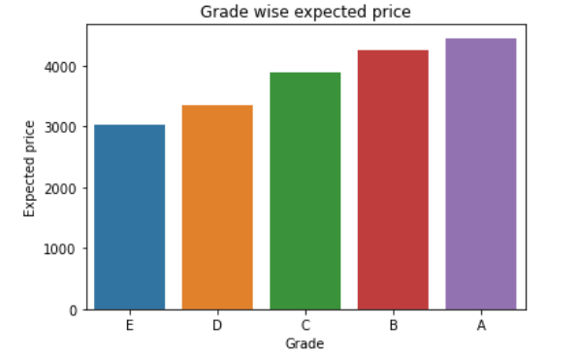
A grade houses are high priced houses and E grade houses are low in price. A grade houses are expensive as compared to E Grade houses.

Slide 4
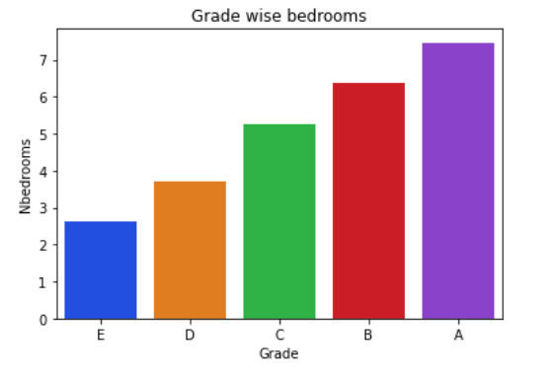
A grade houses having more bedrooms compared to other grade houses or we can say that it is bigger then E grade houses.

Slide 5
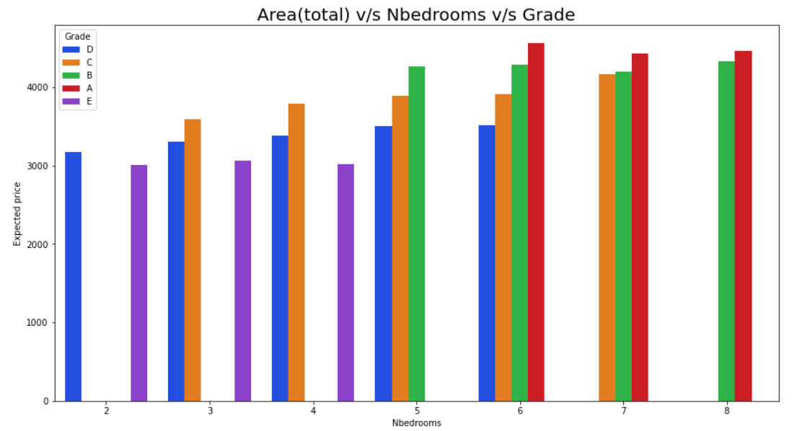
From the above plot we can see that grades distribution over number of bedrooms The more number of rooms are avialable in grade A and B grade houses and the expected price is also more.

Slide 6
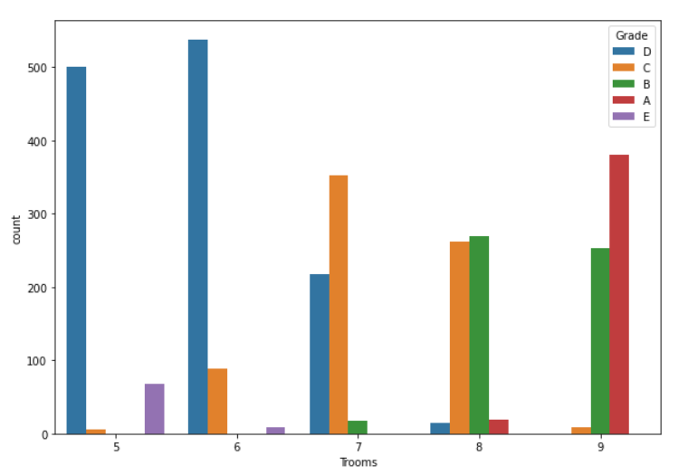
* In grade-A, the total number of rooms in the houses are: 8 and 9. * In grade-B, the total number of rooms in the houses are: 7,8 and 9. * In grade-C, the total number of rooms in the houses are: 6,7 and 8. * In grade-D, the total number of rooms in the houses are: 5,6 and 7. * In grade-E, the total number of rooms in the houses are: 5 and 6

Slide 7
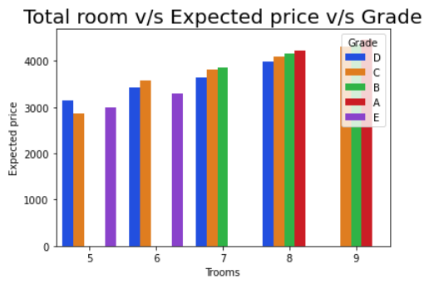
From the above plot we can see that grades distribution over number of rooms The more number of rooms are available in grade A, B and C grade houses and the expected price is also more

Slide 8
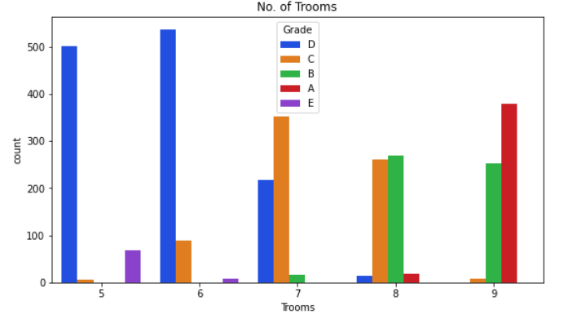
Mostly properties with number of rooms more than 7 are in "Good" condition rating A or B.

Slide 9
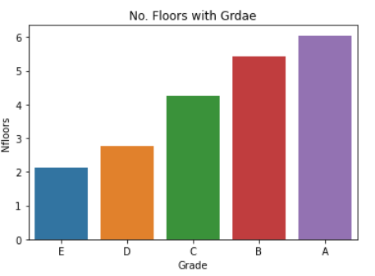
Grade A has the higher number of Floors.

Slide 10
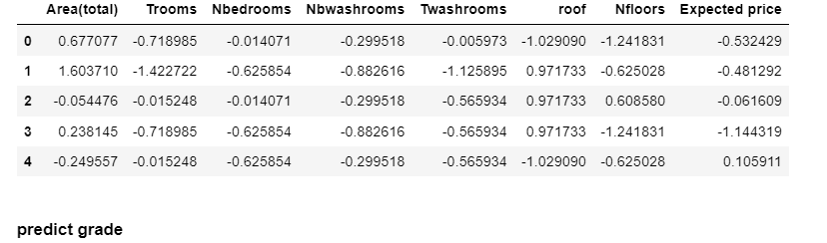
Predicted Grades

Slide 11
Conclusion:-
A grade houses are high priced houses and Grade A has high number of Floors
A grade houses having more bedrooms compared to other grade houses
Houses in Grade-A,B,C most of the houses have roofs
Grade A and B grade houses and the expected price is more with respect to bedrooms
- Mostly properties with number of rooms more than 7 are in Good condition rating with A or B

Slide 12
Thank You!!
.

